Slide 1

CPRG 210 Web Application Development
Module 3: Introduction to CSS

Slide 2
Outlines
HTML Sectioning/Semantics Elements
Introduction to CSS
Pseudo Selectors/Classes
Responsive Web Design
<canvas>, <audio>, <video>, <meter>, <progress>

Slide 3
CSS: Pseudo Selectors/Classes
It is used to define a special state of an element
It can be used to
Style HTML elements when a user moves the mouse over it
Style visited and unvisited links
Style an element when it gets focus
<style type=“text/css”>
a.set1:link{color:red; text-decoration:none}
a.set1:visited{color:yellow; text-decoration:none}
a.set2:link{color:navy; text-decoration:none}
a.set2:visited{color:aqua; text-decoration:none}
</style>
Selector : pseudo-class { property:value; }
https://www.w3schools.com/css/css_pseudo_classes.asp
<a class=“set1” href=“http://www.ibm.com”>IBM</a>
<a class=“set2” href=“http://www.perl.com”>Perl</a>
<a href=“http://www.dell.com”>DELL</a>

Slide 4
Horizontal and Vertical Navigation
Navigation: Section of Webpage
Containing Major Links
Semantically Marked by <NAV>
Not All Links must be in a <NAV>
Example: <FOOTER> may have Links
Creation Steps
2- Links Styling (CSS): Most of Effort
1. Creating Links using <a>

Slide 5
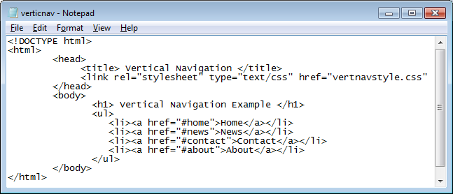
Vertical Navigation Example

Slide 6
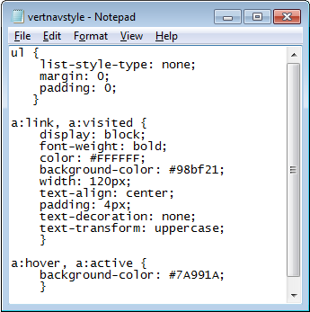
Vertical Navigation Example
A:LINK → Normal, Unvisited Link
A:VISITED → Link Visited by a User
A:HOVER→ Pointed Link
A:ACTIVE → Link at the Clicking Moment

Slide 7
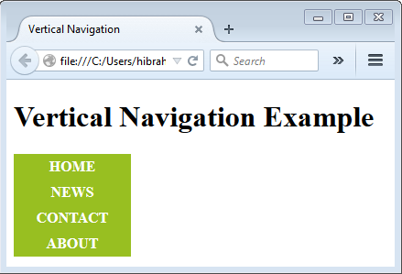
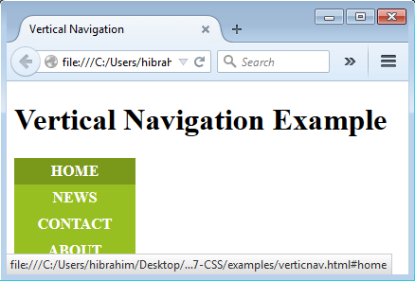
Vertical Navigation Example

Slide 8
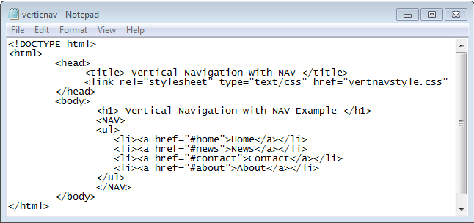
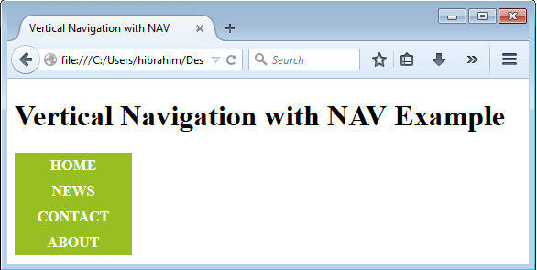
Vertical Navigation with NAV Example

Slide 9
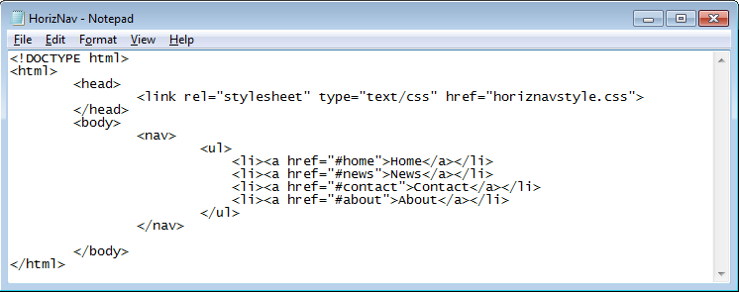
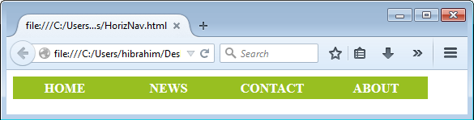
Horizontal Navigation

Slide 10
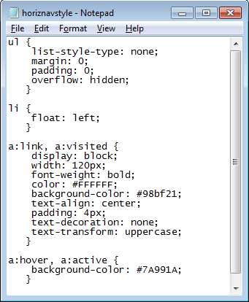
Horizontal Navigation

Slide 11
Responsive Web Design (RWD)
Website design is driven by changing devices and display sizes
Websites were browsed on a monitor with 800x640 pixels resolution.
Site layout was fixed and usually used tables for formatting the layout
Device size explosion = layout must be dynamically adjusted for different screen sizes
CSS provides automatic floating and aligning as screen size changes
use div tags instead of tables
process of designing a website to be used and compatible on different portable or handy electronic devices.
RWD
Also Known as Adaptive Web Design
Giving Optimal Viewing/Browsing User Experience
11

Slide 12
Responsive Web Design (RWD)
A website that adapts to the screen size of devices where the website is being served
Responsive Website
When users resize the page, styling and layout will be adjusted to best fit the new size
1st Way: Do it yourself (e.g. Media Query)
Wrap content in div or semantic tags
Use CSS to set styling/behavior
set size, float, borders, margins, padding, etc.
As browser is resized formatting tags will wrap to display the way you want in new size
http://www.w3schools.com/css/css_responsive_intro.asp
12

Slide 13
Responsive Web Design (RWD)
2nd Way: Use CSS Framework
Examples: Bootstrap (Popular) and Foundation
No need to reinvent the wheel.
The aim of frameworks is to provide a common structure so that developers don’t have to redo it from scratch and can reuse the code provided
http://www.w3schools.com/bootstrap/default.asp
NOTE: we don’t have time to explore Bootstrap in detail today, but check out the tutorial for the basics and we may look at it in more detail later
http://screensiz.es/
13

Slide 14
Responsive Web Design (RWD)
Bootstrap divides devices into 4 categories:
1- Extra Small : Mobiles, Tablets
2- Small: Some Tablets and Netbooks
3- Medium: Laptops
4- Large: Desktop
BS3
@MEDIA(MAX-WIDTH:767PX){}
@MEDIA(MIN-WIDTH:768PX){}
@MEDIA(MIN-WIDTH:992PX){}
@MEDIA(MIN-WIDTH:1200PX){}
CSS technique introduced in CSS3
Use @media to define a set of rules (e.g., MAX-WIDTH or MIN-WIDTH)
Accordingly, Style HTML Elements
@media(Rules){}
Media Query
day3/resonsivebasics.html
14

Slide 15
Practice: Task 1
Check out the following tutorial
http://www.creativebloq.com/responsive-web-design/build-basic-responsive-site-css-1132756
Try out their code and see if you can adapt it to your own pages
15

Slide 16
HTML 5 - Audio
<audio src="audio/test-audio.mp3" controls autoplay> <p>This browser does not support our audio format.</p> </audio>
<AUDIO>
Adding An Audio File
Identification of Source File
<audio controls="controls"> <source src=“myfile.ogg" type="audio/ogg" /> <source src=“myfile.mp3" type="audio/mp3" /> Audio tag not supported. </audio>
Including Controls
Format is not Supported?
Browsers don’t have consistent support of file types
Use source to specify multiple file versions
16

Slide 17
HTML 5 - Video
<Video>
<video src="video/puppy.mp4" poster="images/puppy.jpg" width="400" height="300“
controls loop autoplay> <p>A video of a puppy playing in the snow.</p> </video>
Specifying/Adding A Video File
Identification of Source File
<video width=“400" height=“300“
controls="controls"> <source src=“vid.mp4" type="video/mp4" /> <source src=“vid.ogg" type="video/ogg" /> Video tag not supported.
</video>
Including Controls
Format is not Supported?
Browsers don’t have consistent support of file types
Use source to specify multiple file versions
17

Slide 18
HTML 5 - canvas
<canvas>
Allows Drawing Graphics
Lines, shapes, text, etc.
Needs JavaScript
<canvas id=“example"></canvas>
<script type="text/javascript"> var canvas=document.getElementById(‘example'); var ctx=canvas.getContext('2d'); ctx.fillStyle='#00FF00'; ctx.fillRect(50,50,200,300); </script>
18

Slide 19
HTML 5 – meter & progress
<meter>
measure data within a given range (a gauge)
<meter value=“50" min="0" max="100">50 out of 10</meter><br> <meter value="0.6">60%</meter>
<progress>
Shows the progress of a task
<progress value="20" max="100"> </progress>
Exercise
Do the exercises in “CPRG210 Exercises Day 3.doc”
19

